Slide 1
Constable: Improving Performance and Power Efficiency by Safely Eliminating
Load Instruction Execution
Rahul Bera, Adithya Ranganathan, Joydeep Rakshit, Sujit Mahto, Anant V. Nori, Jayesh Gaur, Ataberk Olgun, Konstantinos Kanellopoulos, Mohammad Sadrosadati, Sreenivas Subramoney, Onur Mutlu
51st International Symposium on Computer Architecture (ISCA)

Slide 2
Problem : Load Instruction
Load instructions cause:
  Data dependence: results of instructions need to be consumed by the other.
  Resource dependence: multiple instructions contend for the same hardware resource.
Thus, load instructions are major source of ILP limitation.

Slide 3
Problem : Load Instruction in Detail
Load instruction takes longer latency than non-memory instructions.
Why? Load instructions need two operations:
  Compute the load address
  Fetch data by accessing memory hierarchy
-> Power & Performance Overhead

Slide 4
Prior Works : LVP & MRN
Load Value Prediction
  LVP predicts the value of a load instruction.
  Speculatively executes load-data-dependent instructions.
Memory Renaming
  MRN learns dependence relationship between a store-load instruction pair.
  Then, speculatively executes load-dependent instruction by forwarding the data directly from the associated store instruction.

Slide 5
Prior Works : Limitations
Predicted or forwarded value has to be verified by actually executing the load.
Incorrect prediction or forwarding: re-execution of load-dependent execution which incurs performance & power overhead.
-> LVP & MRN could mitigate data dependence but not resource dependence.

Slide 6
Motivation
Assume OOO processor with fetch, issue and retire bandwidth of two instructions and one load execution unit and perfect LVP.
There are three instructions and two of them are load instructions.
Comparison processor configuration without LVP, with LVP and LVP + load elimination.

Slide 7
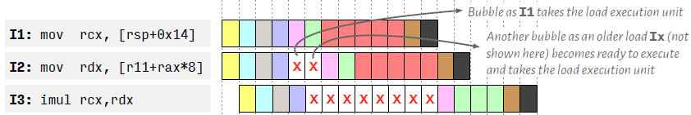
Motivation : Without LVP
I1 issued in cycle 5, thus I2 stalled.
I3 has data-dependence on rdx and rcx, so it must be stalled.
This requires 19 cycles in total.

Slide 8
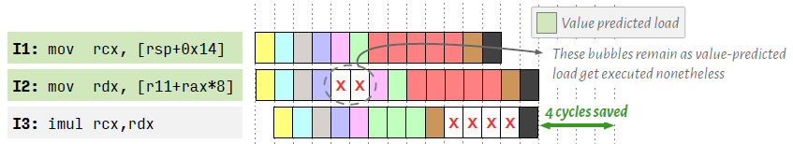
Motivation : With LVP
I1 and I2 are value-predicted. Then, I3 retires 4 cycles earlier.
But predicted values need to be verified, I2 still experiences stalls in cycle 5 and 6.
This requires 15 cycles in total.

Slide 9
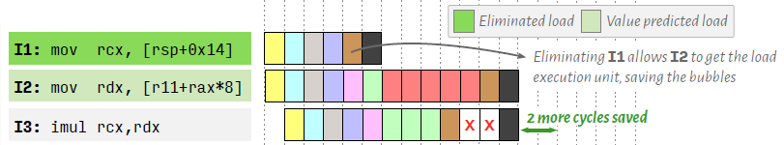
Motivation : With LVP + Load Elimination
If the execution of I1 could be safely eliminated, 2 more cycles can be saved.
This requires 13 cycles in total.

Slide 10
Constable
As we saw above, safe elimination of load can mitigate data dependence but also the resource dependence.
This paper proposes Constable which safely eliminates the entire execution of a load instruction.

Slide 11
Key Observations : Global Stable Loads
Static load instructions repeatedly fetch the same value from the same load address across entire workload trace.
It is called global-stable. This is prime candidate for elimination.
Since address generation & data fetch produce same results across all dynamic instances.

Slide 12
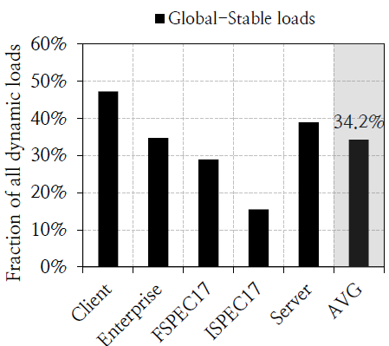
Key Observations : Global Stable Loads
34.2% of all dynamic loads are global-stable.
Significant fraction of load instructions in real workloads are global-stable.
Global stable loads on real workloads

Slide 13
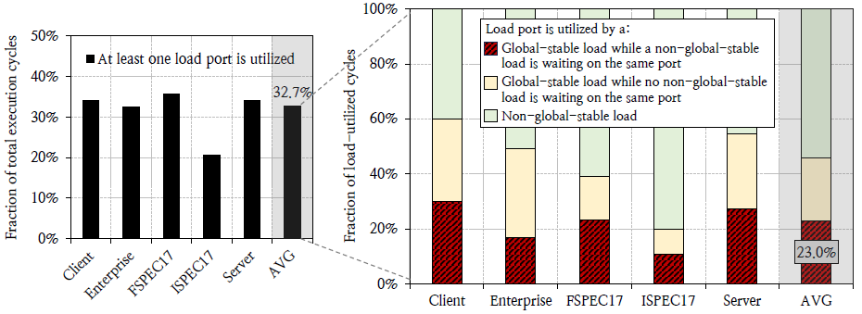
Key Observations : Resource Dependence between Load Instructions
Analysis of the utilization of load ports.
Global-stable & non-global-stable are waiting to be scheduled on the same port.
If global-stable loads are eliminated, non-global-stable could be scheduled faster.
-> Global-stable load instructions cause significant resource dependence!

Slide 14
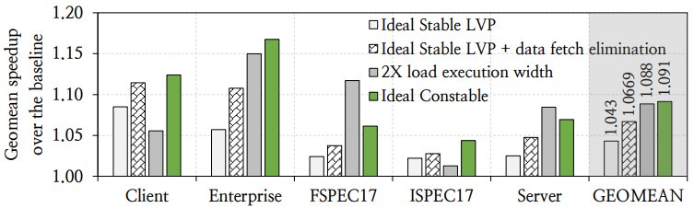
Key Observations : Performance Headroom
Figure shows that eliminating the execution of global-stable loads has high performance headroom.
Mitigating both data and resource dependence has higher performance potential than only mitigating data dependence.
Notes:
그래프 내용 요약 필요

Slide 15
Constable : Key Insight
Condition 1
None of the source registers of I has been written between the occurrences of I1 and I2.
-> Address computation of I2 can be safely eliminated.
Condition 2
No store or snoop request has arrived to the memory address of I1 between the occurrences of I1 and I2.
-> Data fetch operation of I2 can be safely eliminated.
Notes:
내용 관련 약간 수정 필요

Slide 16
Constable : Key Steps
Identifying load instructions
  Constable dynamically identifies load instructions that have repeatedly fetched the same value from the same load address
  This is called likely-stable.
Tracking for modification
  When Constable gains enough confidence that the load instruction is likely-stable,
  Constable tracks modifications to the registers of load instruction.

Slide 17
Constable : Key Steps
Elimination of load instruction
  Constable eliminates the execution of all future instances of the likely-stable load
  Breaks the load data dependence using last fetched value
  Until there is a write to the source registers.

Slide 18
Constable : Main Hardware
Stable Load Detector (SLD)
  PC-indexed table
  Stores key information of last load instruction.
Register Monitor Table (RMT)
  Architectural register-indexed table to monitor modification to architectural registers.
Address Monitor Table (AMT)
  Physical-address-indexed table to monitor modifications in memory.
  Also avoids eliminating a load instruction that is modified.

Slide 19
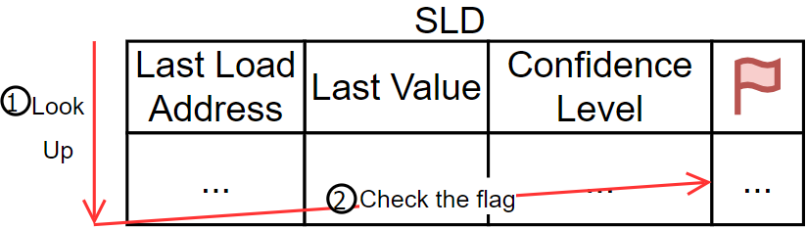
Step 1 : Check SLD
Checks the SLD using load PC during rename stage.
Check can_eliminate flag
  If it’s set -> eliminate load execution.
  If it’s not set -> just execute and re-check the SLD at the writeback stage.

Slide 20
Step 2 : Update Likely-Stable but
Non-Eliminated Load
Update RMT
  Looks up RMT with source register.
  Inserts load PC to RMT entry.
Update AMT
  Looks up AMT with physical address of load instrunction.
  If it’s found -> insert load PC into AMT entry.
  If it’s not found -> inserts load PC into new AMT entry.
Set can_eliminate flag in SLD.

Slide 21
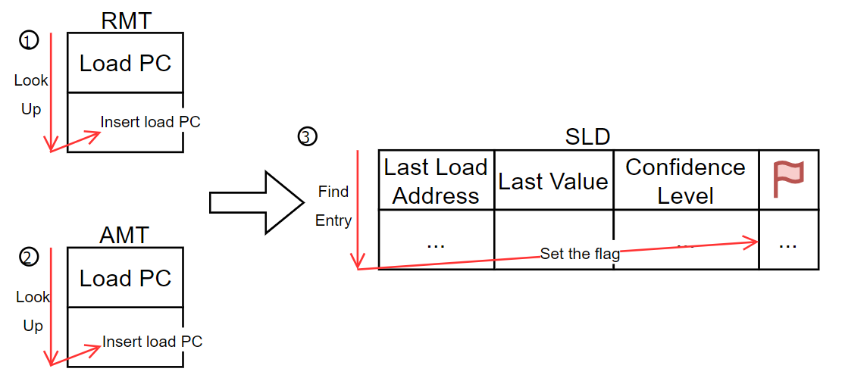
Step 2 : Update Likely-Stable but
Non-Eliminated Load

Slide 22
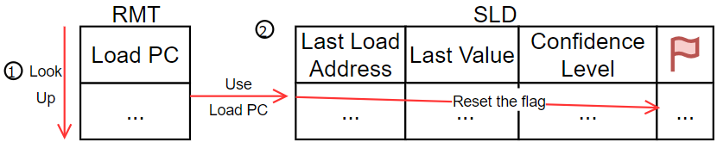
Step 3 : Avoid Wrong Elimination
Looks up RMT with destination register of every instruction during rename stage.
If any load PC in the RMT entry,
  Looks up SLD using load PC.
  Resets the can_eliminate flag since it’s going to be modified.

Slide 23
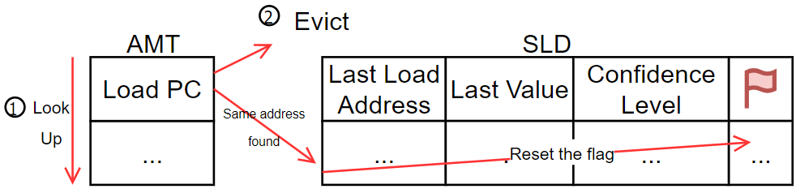
Step 4 : Handling Store Instruction
Looks up AMT with physical address of store instruction and if the same address exists,
  Go SLD.
  Reset can_eliminate flag in that entry.
Evicts the AMT entry.

Slide 24
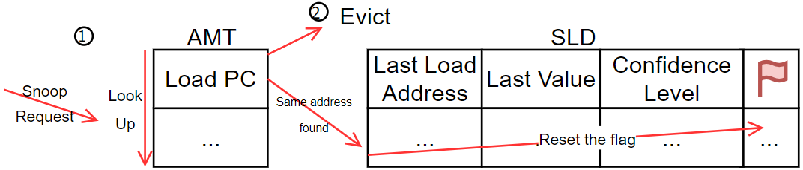
Step 5 : Handling Snoop Request
When snoop request arrives,
  Looks up AMT using the snoop address.
  If the address exists, go SLD and reset can_eliminate flag.
Evict the AMT entry as same as store instruction.

Slide 25
Considerations & Issues
In-flight load dependents
In-flight stores
Cache coherence in multi-core
SLD Design
Wrong path execution
Changes in physical address mapping

Slide 26
In-flight Load Dependent Issue
Constable needs to supply the load value to all dependent in-flight instructions.
Thus small extra register file called xPRF can be used.
xPRF holds the values of eliminated load instructions.

Slide 27
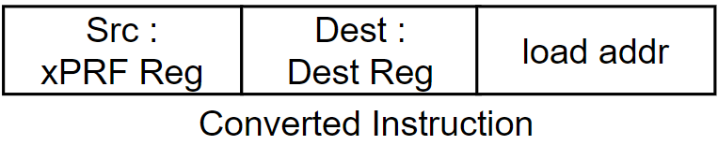
In-flight Load Dependent Issue :
Rename Stage
Load instruction is converted into three-operand register move instruction.
The converted instruction maps its dest reg to src xPRF reg and complete its execution.
Therefore, dependents of converted instruction just need to read xPRF register.

Slide 28
In-flight Load Dependent Issue :
Allocation & Retirement Stage
Converted instruction gets ROB entry and LB entry.
Address field in LB entry gets updated the last-computed load address, the third operand.
This is required for correctly disambiguate the eliminated load from the in-flight stores.
Converted instruction has already been completed before, so it can directly retire.

Slide 29
In-flight Store Issue
There may be eliminated loads that are younger than the store instruction whose addresses match with the store address.
Their elimination might not correct.
Constable solve this issue with existing memory disambiguation logic.
If this issue happens, flushes the pipeline and re-execute all the younger instructions.

Slide 30
Cache Coherence Issue
What is the problem of snoop requests?
Loss of elimination opportunity due to clean eviction at the core-private cache.
Tracking snoop requests at cacheline address granularity.

Slide 31
Cache Coherence Issue : Evicted Cacheline
Load cannot be eliminated if it accesses the evicted cacheline whose core-valid bit was reset.
Drawbacks
  If the evicted cacheline is clean, Constable loses elimination opportunity.
  Design complexity : Constable needs to look up and invalidate AMT entry for every cacheline eviction.

Slide 32
Cache Coherence Issue : Evicted Cacheline
Constable pins the CV-bit of an eliminated load’s cacheline.
Pinning CV-bit ensures that
  Even if the cacheline gets evicted from core-private cache, snoop request gets delivered.
  Constable does not need to look up AMT on every core-private cache eviction.

Slide 33
Cache Coherence Issue : Address Granularity
Snoop request contains a cacheline address, not full memory address.
Constable indexes AMT using physical address at cacheline granularity.
This might incur false address collisions.

Slide 34
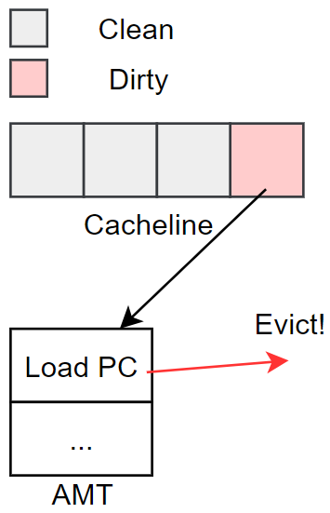
How could the collision occur?
One cacheline might have multiple data.
A data in cacheline was modified by a store instruction.
Other data are not modified, but are regarded as modified.

Slide 35
Cache Coherence Issue : Address Granularity
However, this problem is negligible.
Constable with cacheline-address-indexed AMT has only 0.4% fewer performance than Constable with fully-address-indexed AMT.
Why? Compiler tends to lay out likely-stable load instructions together.

Slide 36
Designing SLD
Every cycle, SLD needs to support enough reads and writes in the rename stage.
98.3% of all workload have less than or equal to two loads on each cycle -> Three read ports.
98.23% of all cycles on average across all workloads have two or fewer SLD updates -> Two write ports.
If there are more than three reads or two writes, then stall the rename stage.

Slide 37
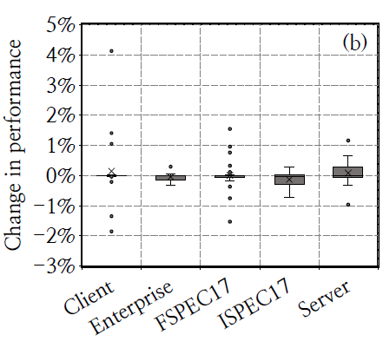
Wrong Path Execution
Constable’s structures may get updated by wrong branch prediction.
This could be restored by branch misprediction recovery.
But, researchers observed that it has negligible performance degradation.
Thus, Constable doesn’t have its own recovery mechansim for branch misprediction
Performance evaluation between correct path instruction vs wrong path execution without recovery

Slide 38
Changes in Physical Address Mapping
Physical memory mapping change -> AMT entry is no more valid for load elimination.
So Contsable resets all can_eliminate flag and invalidates all RMT and AMT entries when the physical memory mapping changes.

Slide 39
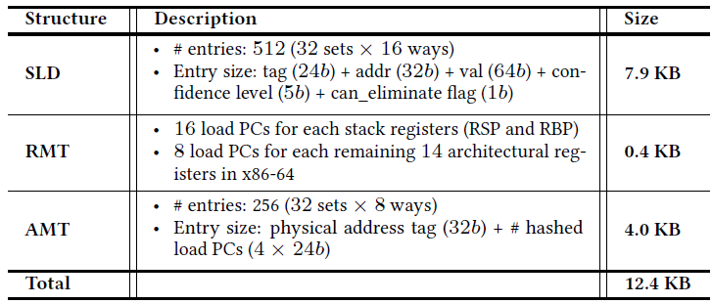
Storage Overhead
Main hardware: SLD, RMT, AMT.
These requires only 12.4 KB storage per core.

Slide 40
Constable vs Prior Works
Early execute address computation
Eliminates data fetch operation
Memoization
Dynamic instruction optimization

Slide 41
Early Execute Address Computation
Some prior works early of fast excute address computation of a load instruction.
These have to execute the load instruction to verify the speculation.
Constable safely eliminates both the address computation and the data fetch operations altogether.

Slide 42
Eliminates Data Fetch Operation
LLVP observe some static load instructions that have highly predictable load values (constant loads).
LLVP bypasses data fetch operations of constant loads.
But this eliminates only the data fetch operations except for address computation.

Slide 43
Memoization
Memoization caches computed results from repeated code executions.
This enables skipping redundant operations.
Or use PC-indexed reuse buffer to store the results of dynamic instances of every static instruction.

Slide 44
Memoization vs Constable
Storage overhead
  Memoization requires large memoization buffer since it targets every static instruction.
  Constable only targets loads.
Resource dependence
  Until the source register values are availabe, retrieval of memoized instruction output may be delayed.
  Constable eliminate load instructions early in the pipeline.
Multi-core Issues
  Needs to keep coherent across memoization buffer.
  Maintains program correctness in the out-of-order load issue.
  Constable addresses all these problems.

Slide 45
Dynamic Instruction Optimization
Enables wide range of runtime code optimizations that removes redundant instructions.
These learn optimizations offline per-trace basis, but Constable lerans online basis and directly to the dynamic instruction stream.
These do not eliminate load instruction in multi-core system to maintain the coherency.

Slide 46
Performance Evaluation
noSMT and SMT Configuration
Performance comparison with prior works
How many load instructions could be eliminated?
Impact on pipeline resource utilization
Power improvement

Slide 47
Methodology
Integrated simulator modeling 6-wide issue Out-of-Order processor.
90 workloads of wide variety.
Configuration
  noSMT
  2-way SMT
Evaluation with three prior works
  EVES : load value predictor
  ELAR : early load address resolution
  RFP : register file prefetching
Golden check
  Verify the correctness of Constable.
  Checks load address and load data.

Slide 48
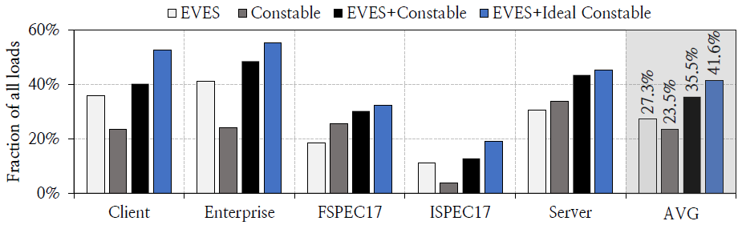
Performance Improvement in noSMT
Constable alone provides similar performance as EVES but only 1/2 of EVES’ storage overhead.
Constable combined with EVES consistently outperforms both EVES and Constable alone in every workload.

Slide 49
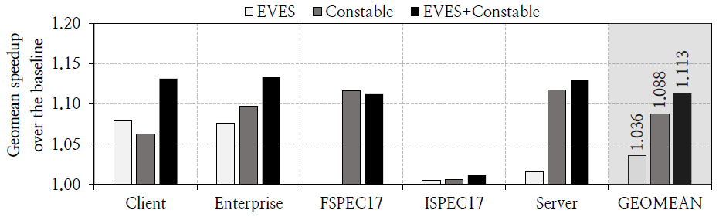
Performance Improvement in 2-way SMT
Constable provides better performance than non-SMT.
Because of high resource contention in SMT.

Slide 50
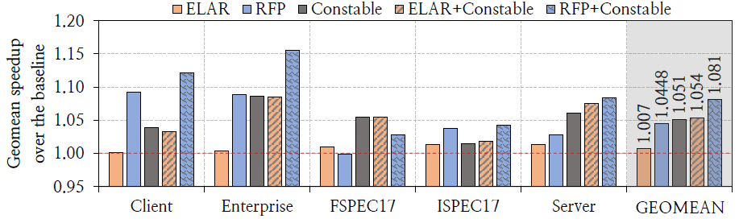
Performance Comparison with Prior Works
Constable alone outperforms both ELAR and RFP.
When combined with ELAR and RFP, Constable provides more performance benefit.

Slide 51
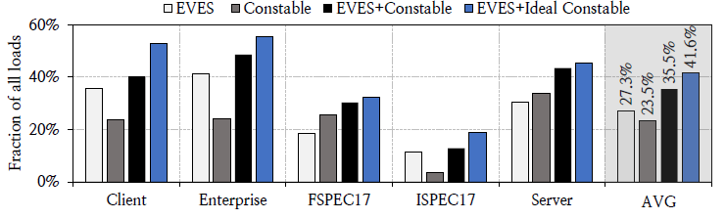
Load Coverage
Constable alone covers 23.5%, EVES does 27.3% since Constable targets loads which have both value and address locality, whereas EVES just targets only shows value locality.
Constable covers significant fraction of the load by itself and combined with EVES.

Slide 52
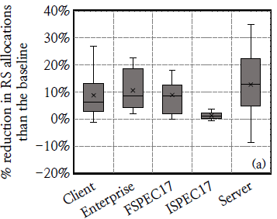
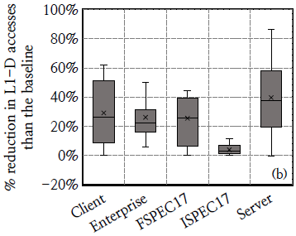
Impact on Pipeline Resource Utilization
Reduction in RS Allocation.
Constable reduces RS allocation by 8.8% on average.
Reduction in L1-D Access.
Constable reduces L1-D allocation by 26.0% on average.

Slide 53
Power Improvement
Key units for power consumption of core
  Front end
  Out of order
  Non-memory execution unit
  Memory execution unit
Key units for Out of Order
  Reservation station
  Register alias table
  Re-order buffer
Key units for memory execution unit
  L1-D cache
  Data translation look-aside buffer

Slide 54
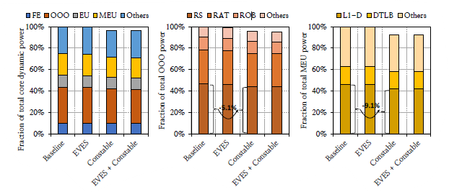
Power Improvement
Constable reduces core power consumption by 3.4% on average over the baseline but EVES does only 0.2%.
Constable reduces power consumed by OOO unit by 4.5% on average over the baseline because Constable significantly reduces RS allocations.
Constable reduces power consumed by MEU unit by 7.2% on average over the baseline because MEU power reduction is dominated by L1-D cache. Constable reduces L1-D accesses.

Slide 55
Summary
Global-stable loads fetch the same data from the same address, and this cause significant ILP loss due to resource dependence.
Constable identifies and eliminates loads that repeatedly fetch same data from same address.
Thus, Constable mitigates data and resource dependence and even reduces the power consumption.

